Slide 1
Slip Plane Modelling
Full Overview of the pipeline and results

Slide 2
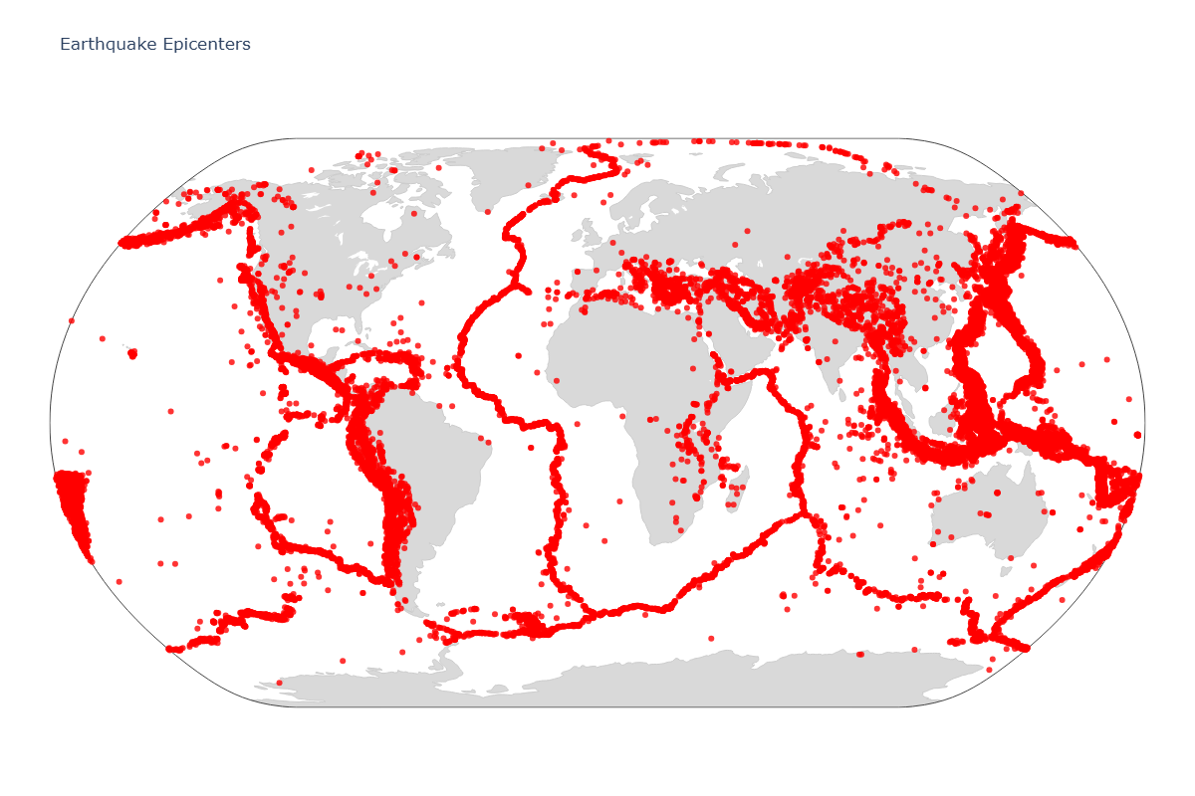

Slide 3
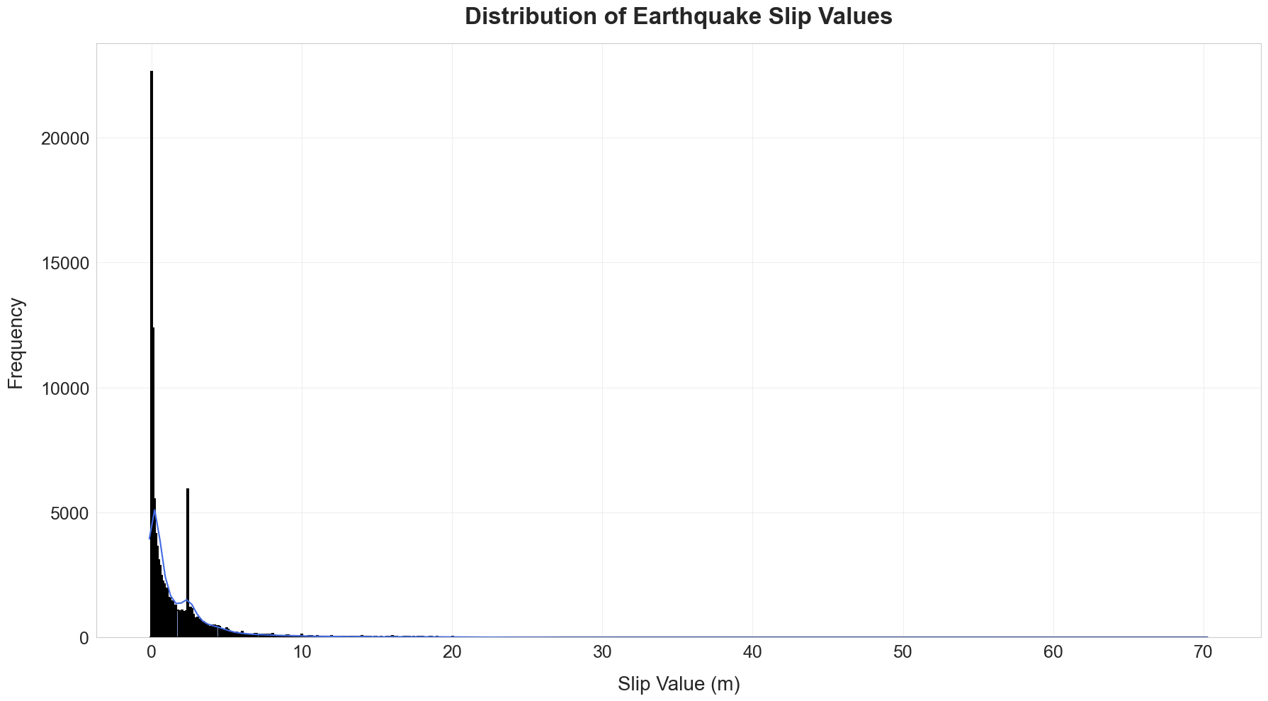

Slide 4
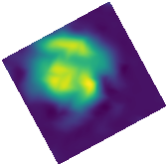
Central Idea –
Using 35 input parameters –
Magnitude of the earthquake
Lat and Long of the epicenter
Fault Dip, Rake and Strike
Depth to the hypocenter.
Seismogenic width
Rupture Area
Moment Magnitude
Shear Modulus
Average Slip, Stress Drop
etc.
PREDICT

Slide 5
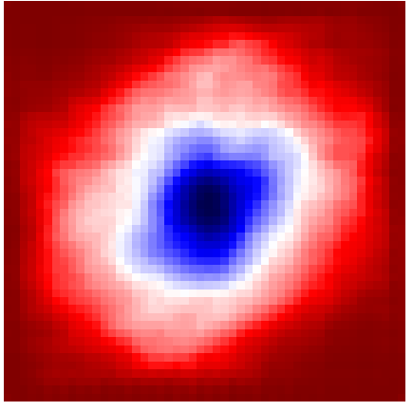

















$$embedding space$$
$$e_{1}$$
$$e_{2}$$
$$e_{3}$$
$$e_{k}$$
……
$$D$$
$$x_{1}$$
$$FFN$$
$$x_{2}$$
$$x_{3}$$
$$decoder$$
$$x_{4}$$
…
…
…
$$x_{35}$$
$$predicted image$$
$$Input$$
$${\hat{z}}_{e}$$
$${\hat{z}}_{q}$$

Slide 6
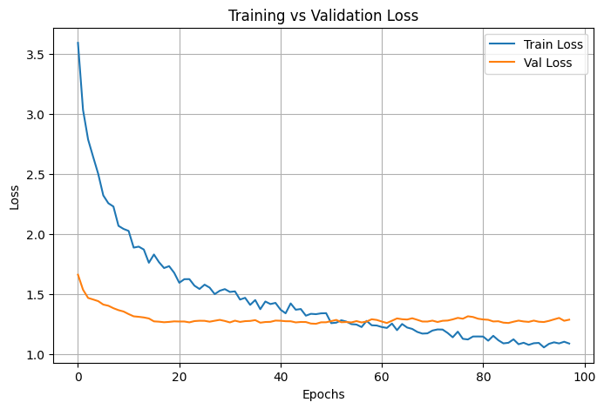

Slide 7
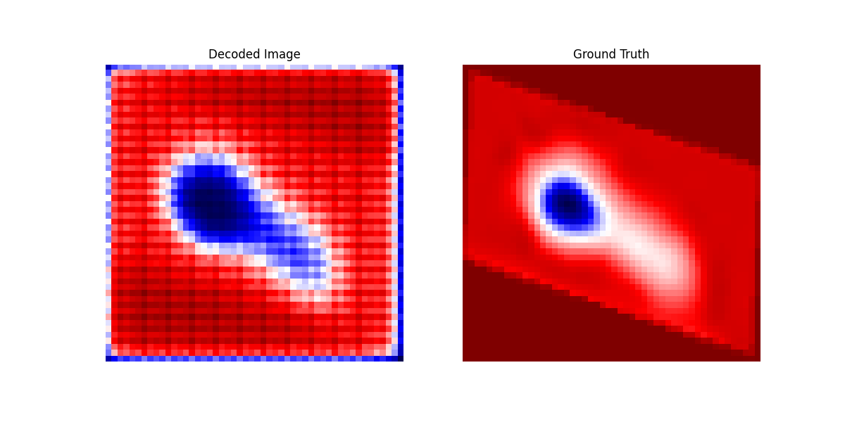

Slide 8
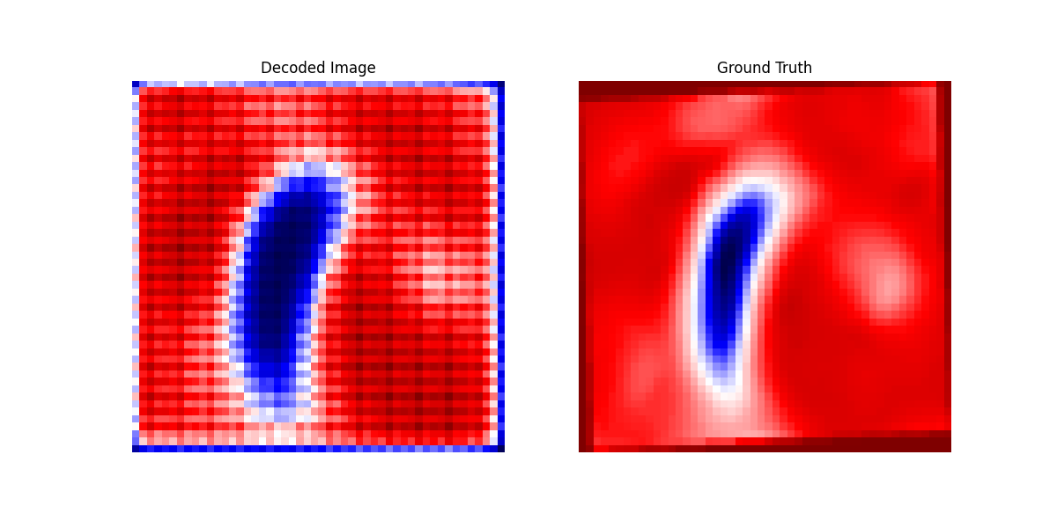

Slide 9
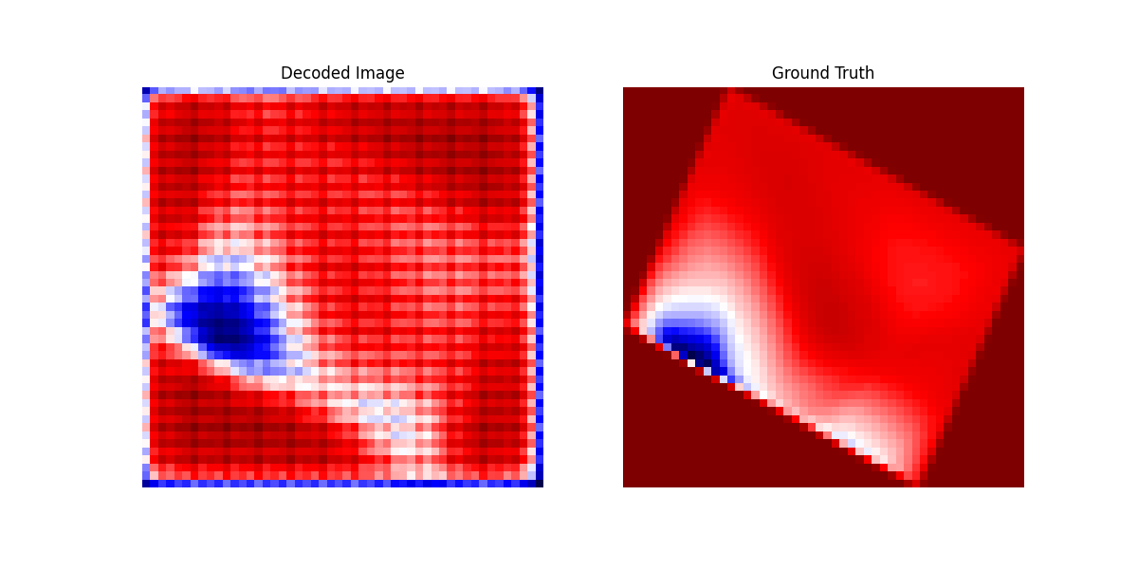

Slide 10
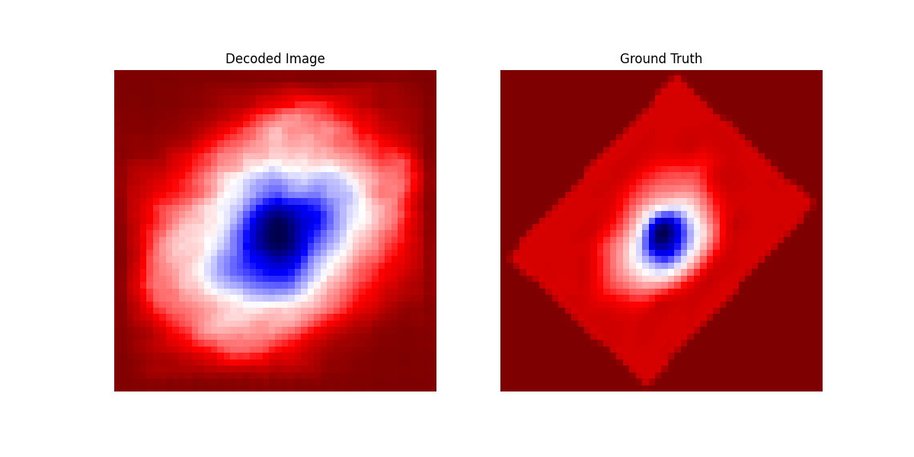

Slide 11
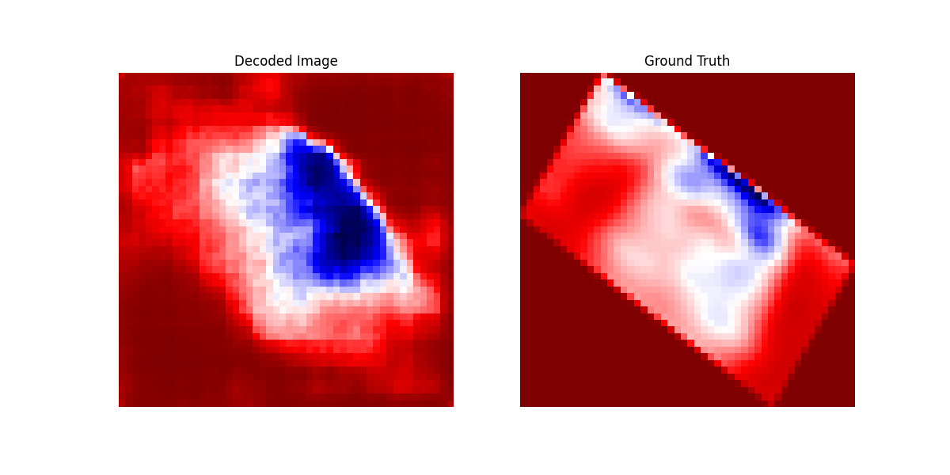

Slide 12
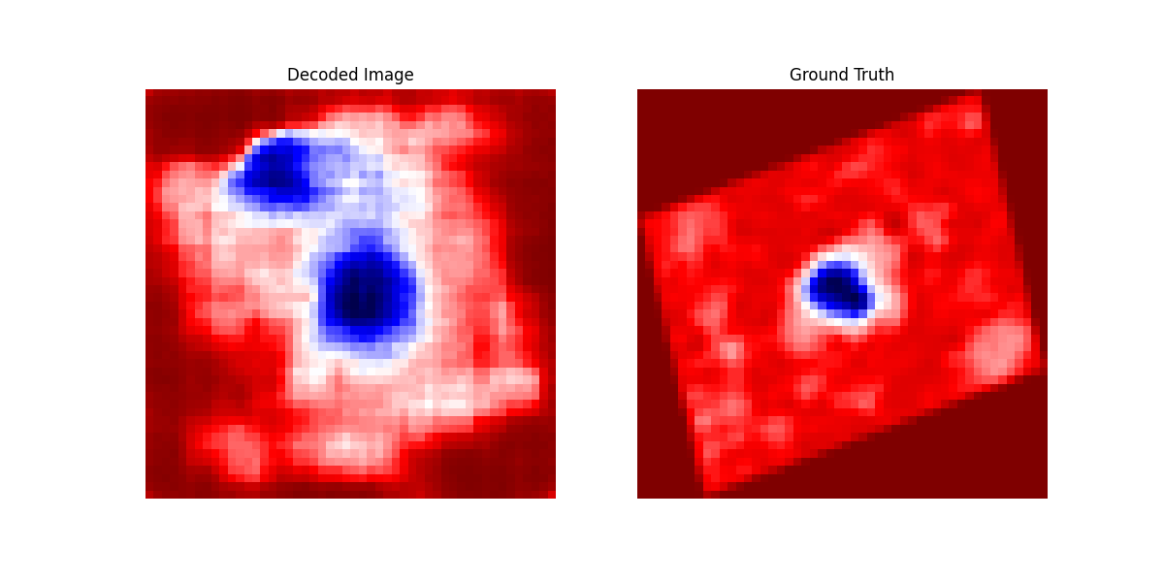

Slide 13
Things to do –
Using 35 input parameters –
Magnitude of the earthquake
Lat and Long of the epicenter
Fault Dip, Rake and Strike
Depth to the hypocenter.
Seismogenic width
Rupture Area
Moment Magnitude
Shear Modulus
Average Slip, Stress Drop
etc.
Future Work–
Reduce the number of params to 5-10.
Conduct an ablation and sensitivity analysis on the input parameters.
Report the results and draft a paper.
Improve

